Slide 1
Emptying Hot Batch
6.19.24 version 1.0

Slide 2
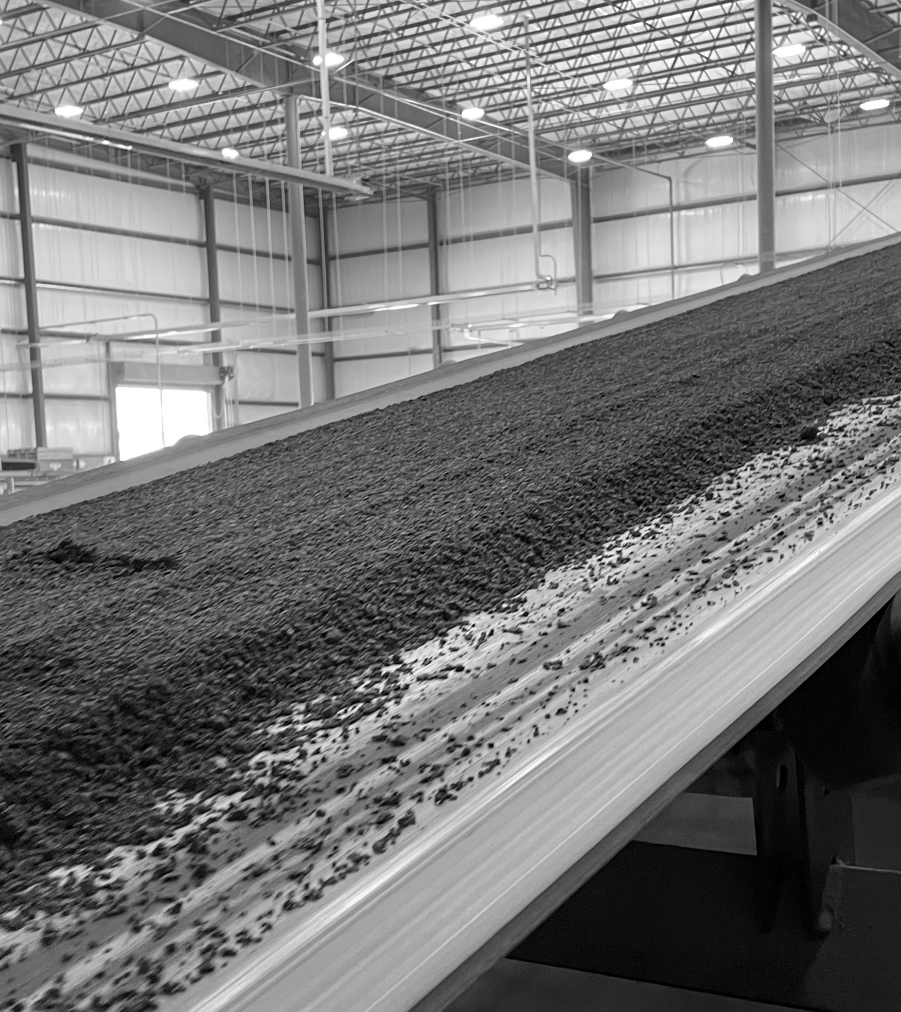
Assumptions and Prerequisite Skills
The computer is on and IntelliBatch 3.0 is open
The machine is presumed to be down for more than 30 minutes
A batch is on hold
Supplies Needed
Forklift with certified driver
Standard PPE Equipment
Shovel
Ladder
Mallet (possibly)

Slide 3
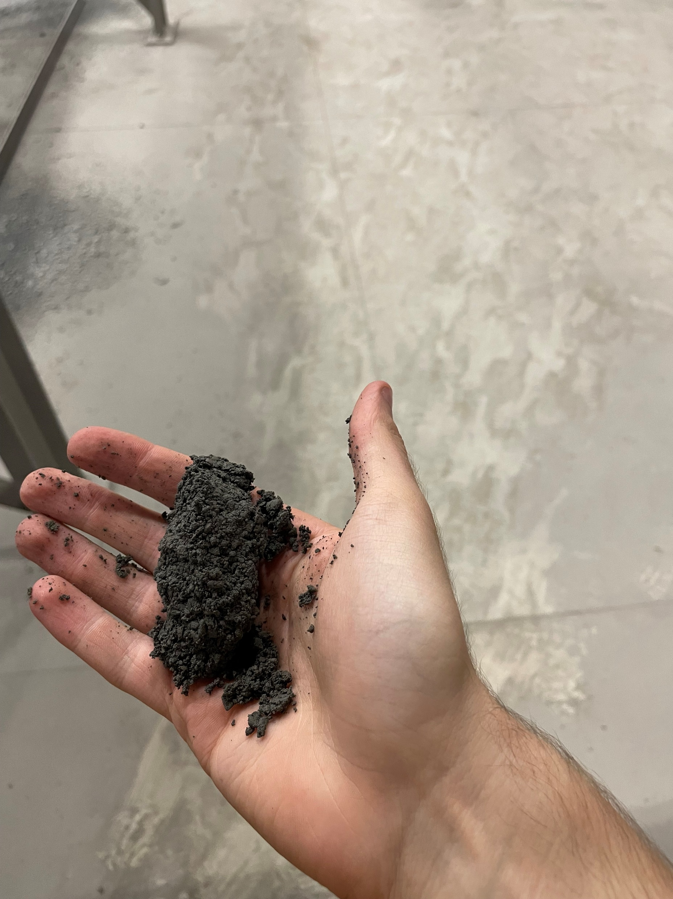
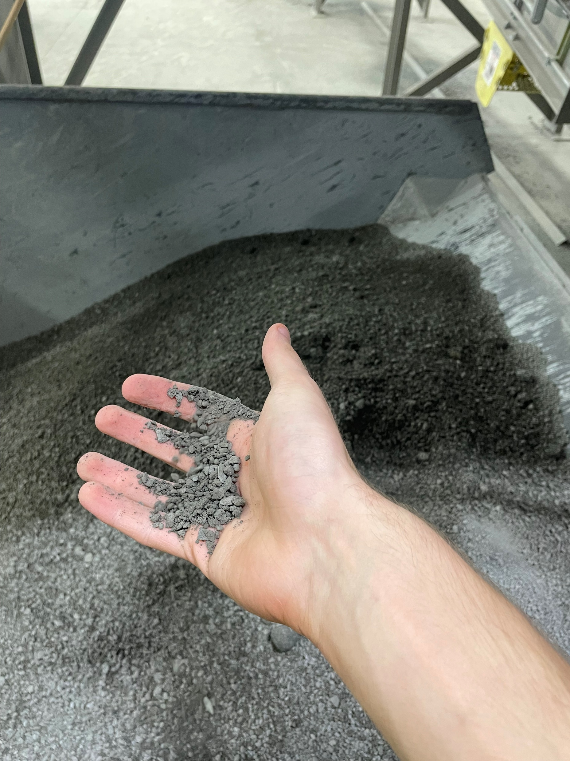
Procedure
If the Besser machine has been down for 30 minutes or longer, and a batch has fully discharged into the holding hopper, there is potential for a dry batch, known as a “hot batch”. If the batch is determined to be hot, the material must be dumped quickly before the material sticks inside the mud hopper.
To determine if a batch is hot:
Go to the machine belt and grab a handful of material.
Squeeze the material. The material should stick together. If it doesn’t, this means the batch is too dry.
Figure 1

Slide 4
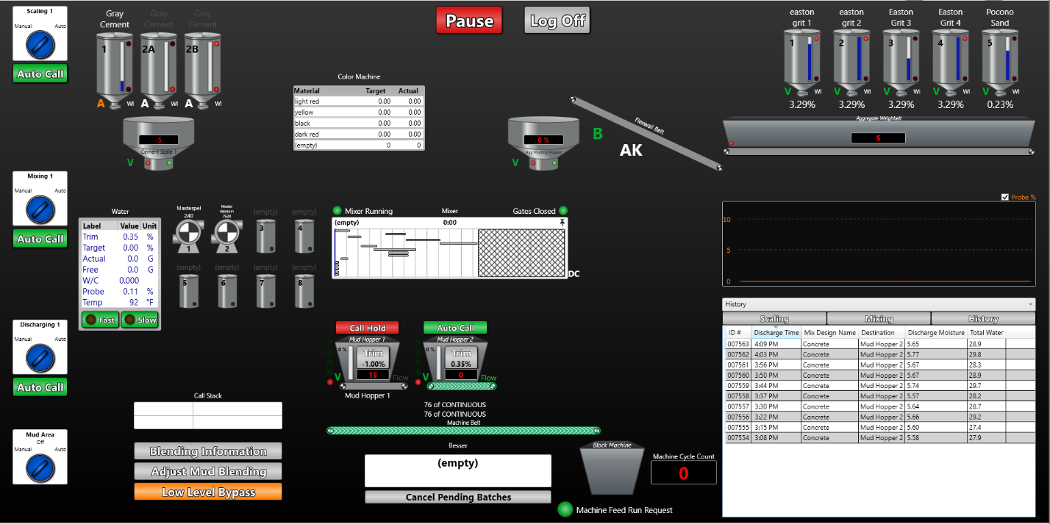
Procedure
2. On IntelliBatch 3.0, press on the “Auto Call” button under the “Mixing 1” switch on the left-hand side of the “Main View” page (Yellow circle in Figure 2).
Figure 2

Slide 5
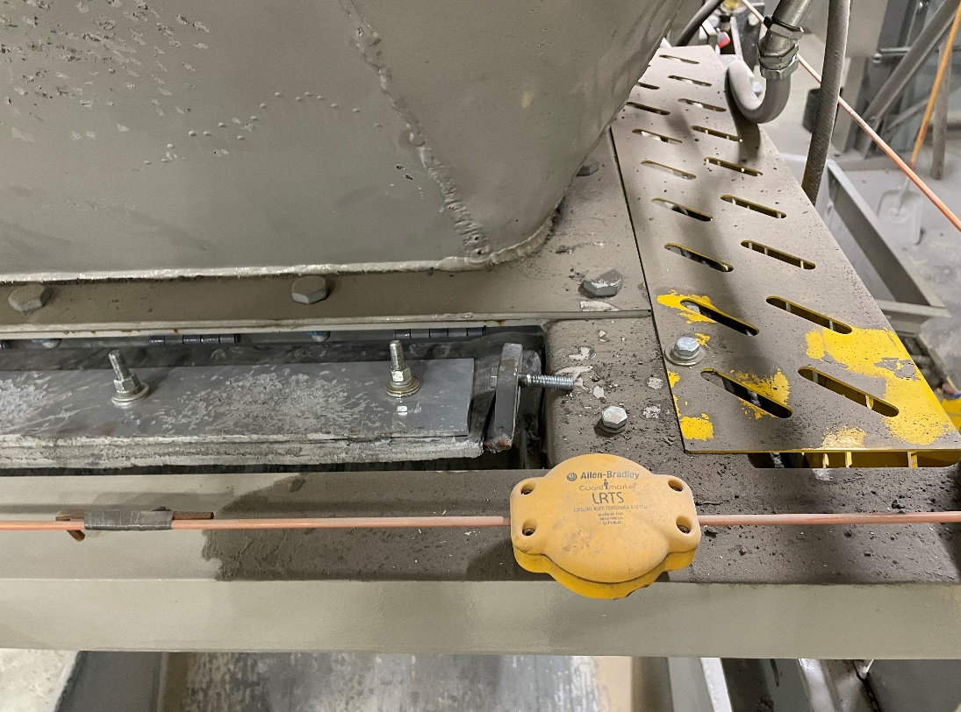
Procedure
3. Open the gate to the Mud Hopper and have the bolt rest on the frame so that the gate stays open (Figure 3).
Figure 3

Slide 6
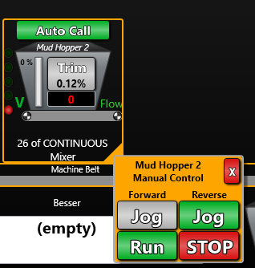
Procedure
4. Go back to the computer. Set Control to manual and run the Mud Hopper 2 belt by clicking run under the reverse tab (Figure 4). All loose debris will start disposing in the waste hopper.
Figure 4. Should look like this

Slide 7
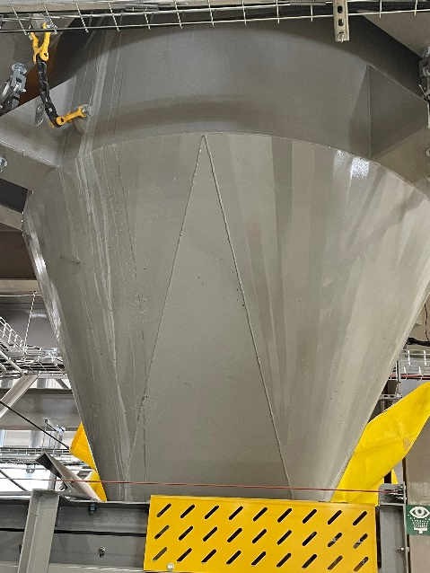
Procedure
5. Check the rate of disposal, if nothing is coming out and more material is in the hopper this means the batch is stuck.
Set up a ladder next to the mud hopper.
Take a mallet and start striking the hopper (Figure 3) repeatedly until material starts coming back out of the gate. If this method is not working, continue to 5c
Figure 5. Shaded in yellow

Slide 8
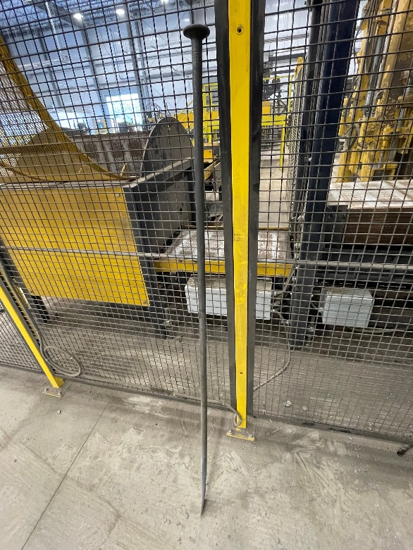
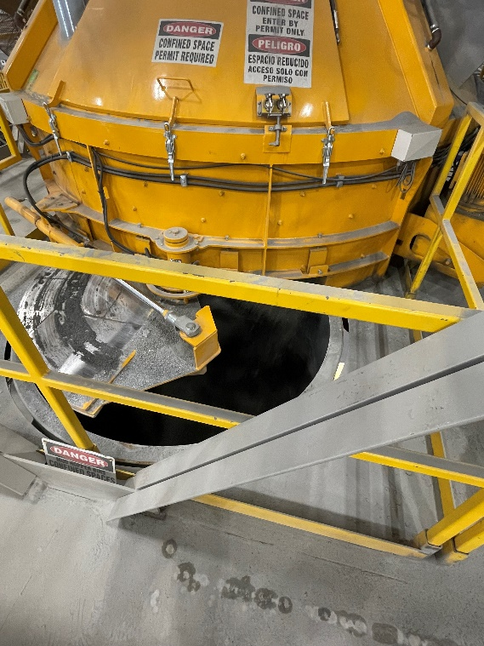
Procedure
5c. Go upstairs to the opening of the mud hopper. Take a metal pole on the rack along the railing (Figure 4) and start poking at the material inside. Be careful not to drop the pole in the hopper.
Figure 6a
Figure 6b

Slide 9
Procedure
6. Watch the status of the waste hopper. If it is full, stop the reverse run and notify the forklift driver that the hopper is ready to be collected and dumped.

Slide 10
Procedure
7. Wait until the hopper is returned and repeat steps 3-6 until there is nothing left in the Mud Hopper. You can find out if the mud hopper is empty by checking the weight value of the hopper (Figure 6) or by going up-stairs and visually checking the hopper from the top. You must visually ensure that there is nothing left in the mud hopper before continuing.
Figure 7

Slide 11
Procedure
8. Click “manual” on the “Mud Area” and click on the orange triangle in the bottom right corner. Click the “Run” button under the reverse tab to dump out any dry material that was on the machine belt.
9. Shovel all the material that fell out of the machine belt into the nearest waste hopper.

Slide 12
Procedure
10. When it’s visually confirmed that everything is out of the mud hopper, Press the “Stop” button under the reverse tab (Blue circle in Figure 7).
Figure 8

Slide 13
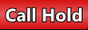
Procedure
11. Lock up the mud hopper gate and press the “Call Hold” button under the “Mixing 1” switch (Figure 8). This allows the next batch to continue to its automatic process.
Figure 9

